Slide 1
Lecture 07: 8255 PPI Chip

Slide 2
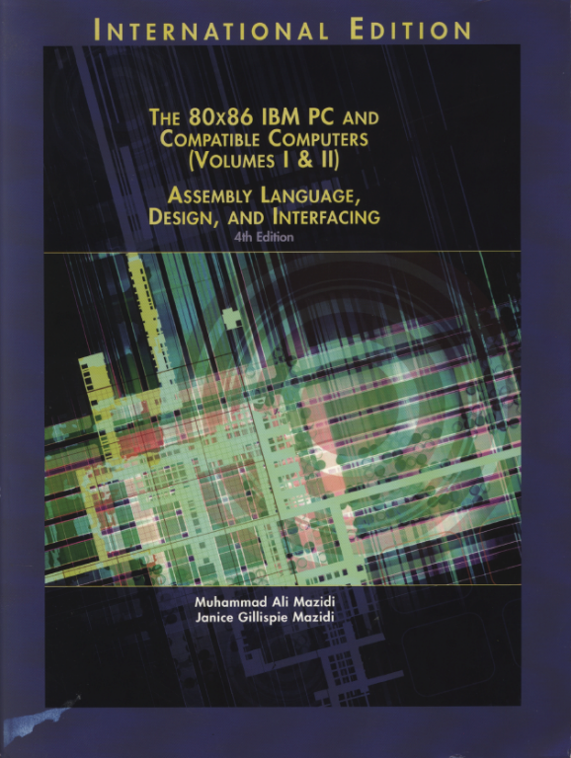
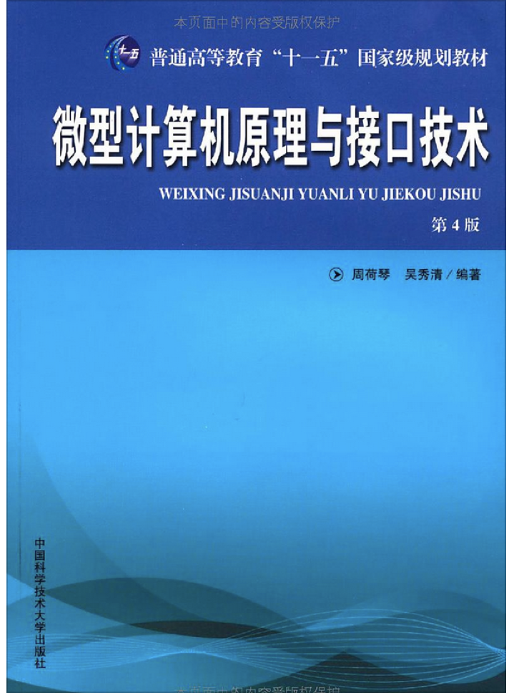
Reference Book:
The 80x86 IBM PC and Compatible Computers
Chapter 11 I/O and the 8255
PPI: Programmable Parallel Interface (so it is an I/O module)
微型计算机原理与接口技术（第四版）
第9章 可编程外围接口芯片8255A及其应用

Slide 3
Recall in Lecture 02: I/O Module Diagram
Systems Bus Interface
External Device Interface
External
Device
Interface
Logic
Data
Data
Lines
Data Register
Status
Status/Control Register
Control
Address
Lines
Input
Output
Logic
External
Device
Interface
Logic
Data
control
Lines
Status
Control

Slide 4
Package & Internal Structure

Slide 5
Internal Structure and Pins
Three data ports: A, B, and C
Port A (PA₀~PA₇): can be programmed all as input/output
Port B (PB₀~PB₇): can be programmed all as input/output
Port C (PC₀~PC₇): can be split into two separate parts PCU and PCL; any bit can be programmed individually
Control register (CR)
Internal register: used to setup the chip
Group A, Group B and control logic
Group A (PA & PCU)
Group B (PB & PCL)

Slide 6
Internal Structure and Pins
Data bus buffer
An interface between CPU and 8255
Bidirectional, tri-state, 8-bit
Read/Write control logic
Internal and external control signals
RESET: high-active, clear the control register, all ports are set as input port
~CS, ~RD, ~WR
A₁, A₀: port selection signals
~CS A₁ A₀ | ~RD ~WR | Function
0 0 0 | 0 1 | PA->Data bus
0 0 1 | 0 1 | PB->Data bus
0 1 0 | 0 1 | PC->Data bus
0 0 0 | 1 0 | Data bus->PA
0 0 1 | 1 0 | Data bus->PB
0 1 0 | 1 0 | Data bus->PC
0 1 1 | 1 0 | Data bus->CR
1 × × | 1 1 | D₀~D₇ in float

Slide 7
Operation Modes
Input/output modes
Mode 0, simple I/O mode:
PA, PB, PC: PCU{PC₄~PC₇}, PCL{PC₀~PC₃}
No Handshaking: negotiation between two entities before communication
Each port can be programmed as input/output port
Mode 1:
PA, PB can be used as input/output ports with handshaking
PCU{PC₃~PC₇}, PCL{PC₀~PC₂} are used as handshake lines for PA and PB, respectively
Mode 2:
Only PA can be used for bidirectional handshake data transfer
PCU{PC₃~PC₇} are used as handshake lines for PA
Bit set/reset (BSR) mode
Only PC can be used as output port
Each line of PC can be set/reset individually

Slide 8
Control Register & Op. Modes
Control Register
A 8-bit internal register in 8255
Selected when A₁=1, A₀=1
Mode selection word
Input/output modes
BSR mode

Slide 9
Select Input/output Modes
Input/output modes
Group A control
Group B control

Slide 10
Select Input/output Modes
Input/output modes

Slide 11
Select Input/output Modes
Input/output modes

Slide 12
Select Input/output Mode Examples
1. Write ASM instructions for setting the 8255 in simple I/O mode with PA and PB being output port and PC being input port.
2. Assume that the address of the control register of the 8255 is 63H, give out the instructions that set up the 8255 in mode 0 where PA, PB and PCU are used as input ports and PCL is used as output port.
MOV AL, 10001001B
MOV DX, ContralPort
OUT DX, AL
MOV AL, 10011010B
OUT 63H, AL

Slide 13
Select BSR Mode
BSR Mode
Arbitrary value
Indicate which line in PC:
000 – PC₀
001 – PC₁
…
111 – PC₇
0 – Reset
1 – Set

Slide 14
Select BSR Mode Examples
Assume PC is used as an output port which connects to 8 LED segments, now turn off the second LED segment with the rest unchanged (e.g., for LED segments in this case, 1-on, 0-off).
Using BSR mode instead:
MOV AL, 10000000
OUT ContralPort, AL
…
IN AL, CPORT
AND AL, 11111101B
OUT CPORT, AL
MOV AL, 00000010B
OUT ControlPORT, AL

Slide 15
Select BSR Mode Examples
Assume the address range for a 8255 is 60H~63H, PC₅ is outputting a low level, write code to generate a positive pulse.
MOV AL, 00001011B ; set PC₅ high level
OUT 63H, AL
MOV AL, 00001010B ; set PC₅ low level
OUT 63H, AL

Slide 16
Mode 0 (Simple I/O)
For simple input/output scenario
No handshaking needed
Any port of PA, PB and PC (PCU, PCL) can be programmed as input or output port independently
PCU=PC₄~PC₇, PCL=PC₀~PC₃
CPU directly read from or write to a port using IN and OUT instructions
Input data are not latched, Output data are latched
E.g., setting up the control register for Mode 0

Slide 17
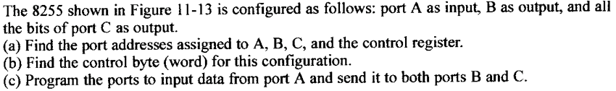
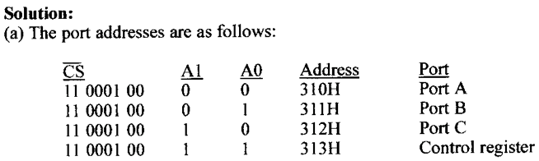
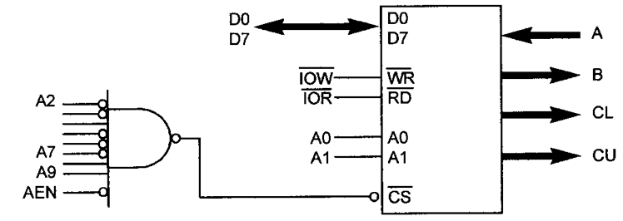
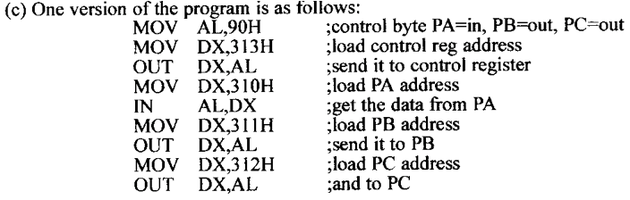
Mode 0 Example

Slide 18
Mode 1 (Strobe I/O)
For handshake input/output scenario
PA and PB can be used as input or output ports
PCU=PC₃~PC₇, used as handshake lines for PA
PCL=PC₀~PC₂, used as handshake lines for PB
Both input and output data are latched

Slide 19
Mode 1: As Input Ports
PC₃~PC₅ and PC₀~PC₂ are used as handshake lines for PA and PB, respectively
~STB: the strobe input signal from input device loads data into the port latch
IBF: Input Buffer Full output signal to the device indicates that the input latch contains information (can also be used for programmed I/O)
INTR: Interrupt request is an output to CPU that requests an interrupts (for interrupted I/O)
PC₆ and PC₇ can be used as separate I/O lines for any purpose
INTE: the interrupt enable signal is neither an input nor an output; it is an internal bit programmed via the PC₄ (port A) or PC₂ (port B); 1-allowed, 0-forbidden

Slide 20
Mode 1: As Input Ports
Control register
PC stores all status information
Indicates Group A Mode 1
PC₆, PC₇:
1-input
0-output
PB: Input
PA: Input
Indicates Group B Mode 1

Slide 21
Timing in Mode 1 Input
Input device first puts data on PA₀~PA₇, then activates ~STB_{A}, data is latched in Port A;
8255 activates IBF_{A} which indicates the device that the input latch contains information but CPU has not taken it yet. So device cannot send new data until IBF_{A} is cleared;
When IBF_{A}, ~STB_{A} and INTE_{A} are all high, 8255 activates INTR_{A} to inform CPU to take data in PA by interruption;
CPU responds to the interruption and read in data from PA; the ~RD signal will clear INTR_{A} signal;
After CPU finishes reading data from PA (i.e., ~RD signal goes high), the IBF_{A} signal is cleared.

Slide 22
Mode 1: As Output Ports
PC₃, PC₆, PC₇ and PC₀~PC₂ are used as handshake lines for PA and PB, respectively
~OBF : Output buffer full is an output signal that indicates the data has been latched in the port
~ACK : The acknowledge input signal indicates that the external device has taken the data
INTR: Interrupt request is an output to CPU that requests an interrupts
PC₄ and PC₅ can be used as separate I/O lines for any purpose
INTE: the interrupt enable signal is neither an input nor an output; it is an internal bit programmed via the PC₆ (port A) or PC₂ (port B); 1-allowed, 0-forbidden

Slide 23
Mode 1: As Output Ports
Control register
PC stores all status information
Indicates Group A Mode 1
PC₄, PC₅:
1-input
0-output
PB: Output
PA: Output
Indicates Group B Mode 1

Slide 24
Timing in Mode 1 Output
If INTR_{A} active, CPU responds to the interruption and writes data to PA and clears the INTR_{A} signal;
When data has been latched in PA, 8255 activates ~OBF_{A} which informs the output device to pick up data;
After the output device has taken the data, it sends ~ACK_{A} signal to 8255 which indicates that the device has received the data, and also makes ~OBF_{A} go high, indicating CPU can write new data to 8255;
When ~OBF_{A}, ~ACK_{A} and INTE_{A} are all high, 8255 sends an INTR_{A} to inform CPU to write new data to PA by interruption.

Slide 25
Mode 2 (Bidirectional Bus)
For bidirectional handshake input/output scenario
Only PA can be used as both input and output port
PCU=PC₃~PC₇, used as handshake lines for PA
Both input and output data are latched

Slide 26
Mode 2: As Input & Output Port
PC₃ ~ PC₇ are used as handshake lines for PA
~OBF_{A}, ~ACK, IBF_{A}, ~STB_{A}, INTR_{A}
PC₀ ~ PC₂ can be used as separate I/O lines for any purpose, or as handshake lines for PB
When CPU responds to an interrupt of 8255 working in Mode 2, the interrupt handler has to check the ~OBF_{A} and IBF_{A} in order to tell whether the input process or the output process is generating the interrupt.

Slide 27
Mode 2: As Input & Output Port
Control register
PC stores all status information
Indicates Group A Mode 2

Slide 28
Polling vs. Interruptions
In Mode 1 and 2, PC stores status of Group A and/or Group B
By reading from PC using IN instruction, you can use polling method to check the state of I/O devices

Slide 29
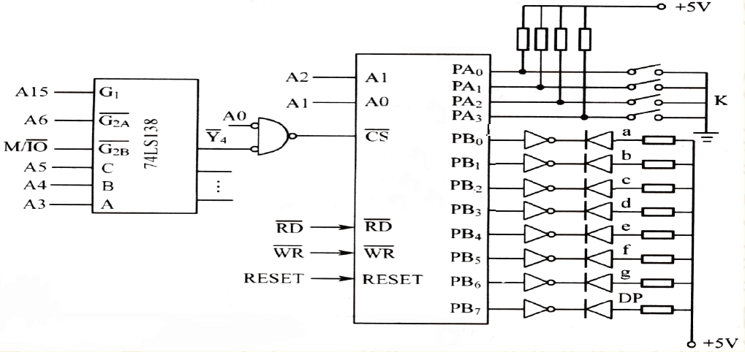
Programming with 8255
As shown in the figure, PA and PB of the 8255 are working in mode 0. PA used as input port connects to 4 switches, and PB used as output port connects to a 7-segment LED. Write a program to display a hex digit that the switches can represent.

Slide 30
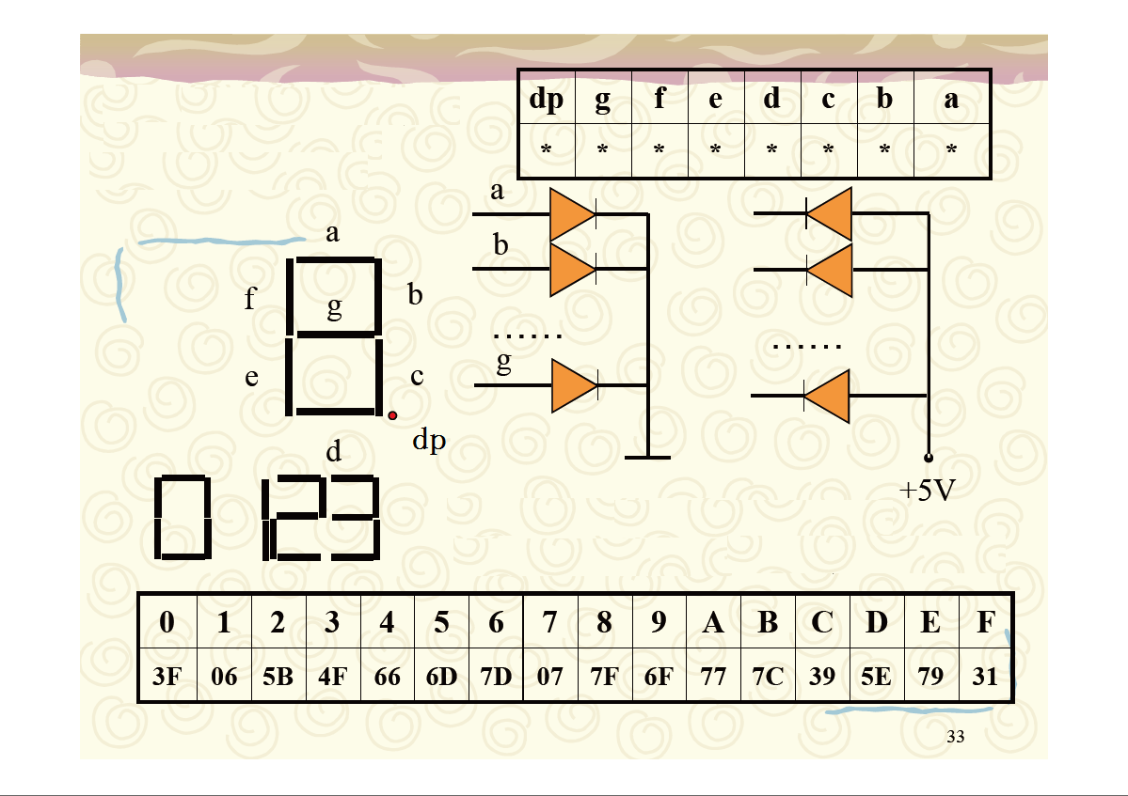

Slide 31
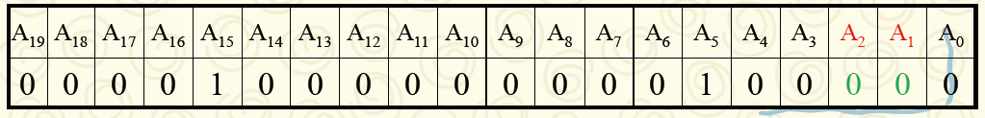
Address Decoding
What are the addresses of ports and the control register?
PA : 8020H
PB : ?
PC : ?
CR : ?

Slide 32
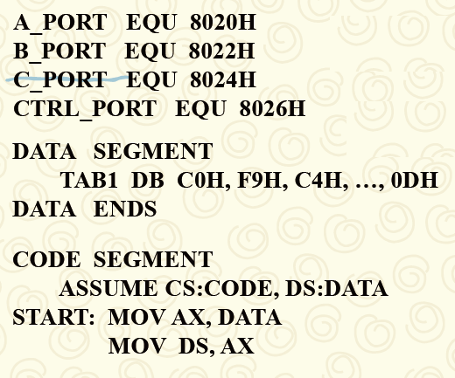
A Solution Program

Slide 33
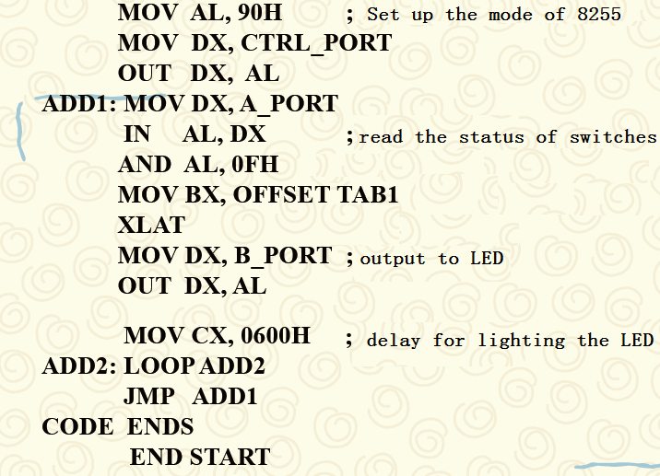
A Solution Program

Slide 34
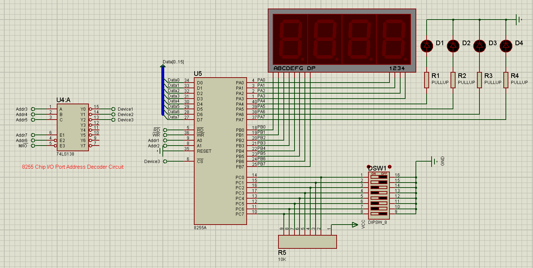
Experiment 2

